Slide 1
Embedded C Programming
Debug and Test
Nitin Chandrachoodan, IIT Madras

Slide 2
Debugging

Slide 3
Single Step Debug
Breakpoint: Mark a point in the code where the system should stop
How?
Non-interactive: insert invalid instruction and crash system: usually logged as “core dump”
Interactive:
Trap / software invoked interrupt instruction
Invalid instruction - catch exception and handle
Variants
Conditional breakpoints
Logpoints

Slide 4
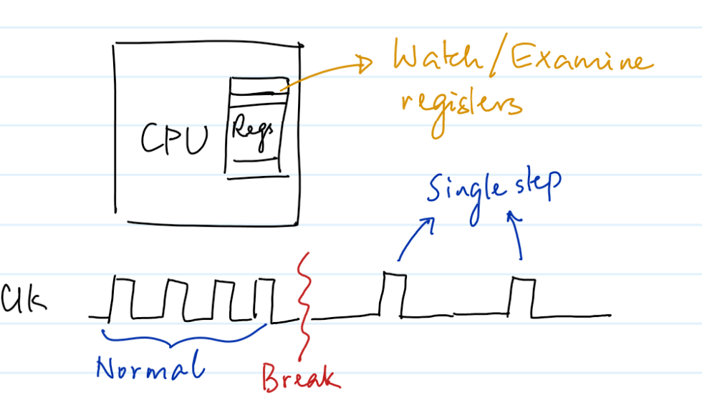
Stepping (debugging)
After breakpoint:
allow single cycle steps through code
examine registers
modify (?)
examine / modify memory
Hardware support usually required
In-circuit debugging

Slide 5
Why hardware debug?
Hardware != Software
Simulators cannot model all physical conditions
Real-time interaction very hard to simulate
Analog, non-deterministic inputs
Even single-step is different from real scenarios
Multi-processor / Multi-tasking systems even harder to debug

Slide 6
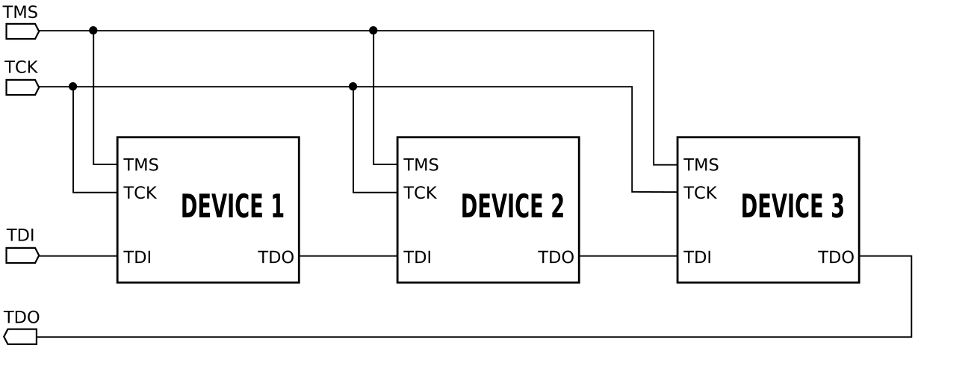
JTAG
IEEE 1149.1 standard - Joint Test Action Group
Originally developed for testing hardware
Repurposed for software debug
“Daisy Chain” architecture
“Boundary Scan”

Slide 7
Use of JTAG
All registers in a system connected in a chain
Bypass between elements in daisy chain for efficient access
Use instructions and modes
Set values of individual registers
Read values from individual registers
Software context:
Provides access to on-chip debug modules
Can be used to extract register values, set memory contents etc.

Slide 8
Single-Wire Debug (SWD)
ARM-specific debug bus
SWCLK - clock signal to synchronize tracing
SWDIO - debug data in/out
(Optional) SWO - debug trace output
Compared to JTAG?
Specific for SW debug - not boundary scan; also ARM specific
Generally faster than JTAG; fewer pins
JTAG more flexible; supports more devices

Slide 9
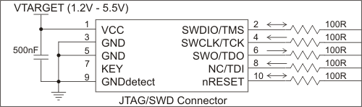
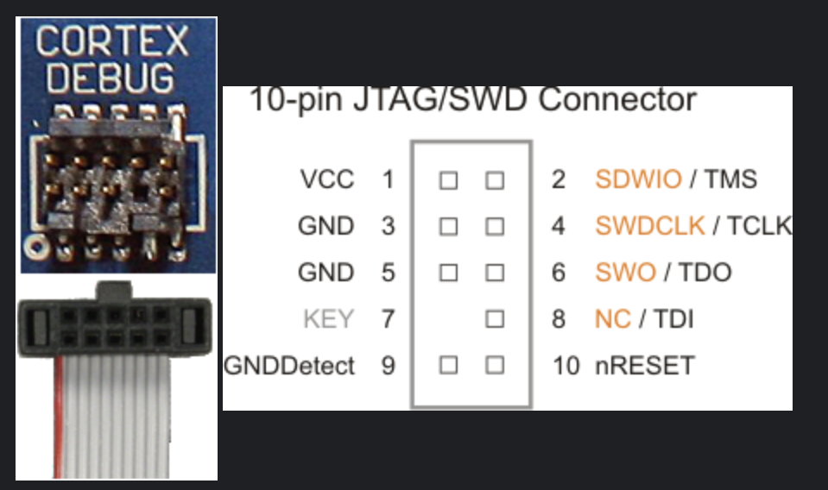
Physical Connectors

Slide 10
IDE
Integrated Development Environment
STMCube, Keil, CCS etc. Eclipse as a general purpose platform
Debug support
Integrate with hardware debuggers

Slide 11
Summary
Debugging essential part of checking program correctness
Tools like formal verification and specification are even more important
Beyond scope of this course - important to track future developments
Pure software debugging:
OS support, binary modifications
Hardware support
JTAG, SWD
Essential for embedded systems

Slide 12
Profiling

Slide 13
Profiling
Analyze run-time behaviour of a program
Identify performance bottlenecks
Identify memory resource constraints
Identify scope for improvement

Slide 14
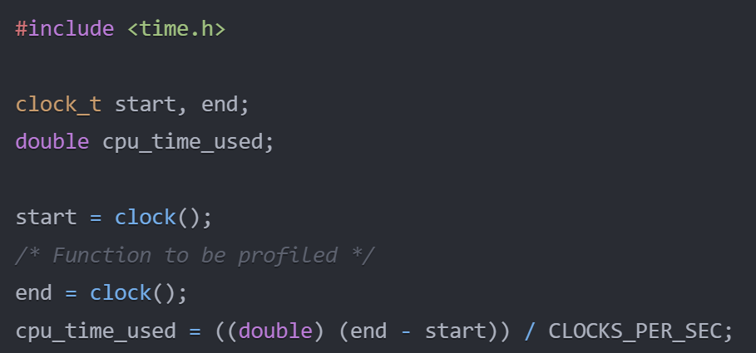
Technique: Instrumentation
Insert timing code at beginning and end of “points of interest”
Overhead due to instrumentation code
Limited by measurement accuracy

Slide 15
Technique: Sampling
Periodically ‘sample” or record the program counter
Over time, build up a picture of where the program spent most of its time
Less overhead than instrumentation
Possibility of missing events

Slide 16
Tool: gprof
GNU profiler: common on most Linux-like systems
Combination of instrumentation and profiling
Call graph - connectivity diagram across function calls
Estimate time spent in each function and descendants
Identify bottlenecks

Slide 17

Tool: Valgrind
Suite of debugging tools - primarily for Linux and Unix-like systems
Helps with
Memory bugs
Threading (race) bugs
Performance issues

Slide 18
Valgrind
How?
Dynamic binary instrumentation (modify binary executable without needing source changes)
Virtual environment to run code
Instrumentation (extra code added, function calls intercepted)
Analysis
What?
Memory errors:
Uninitialized memory, leaks, overflows
Threading bugs
race conditions, deadlocks
Performance issues
Time spent, cache, branch predictions
Heap profiling
Dynamic memory allocation

Slide 19
Embedded Systems
Limited resources:
instrumentation overhead may add too much code
Interference with running:
time critical optimized code - behaviour changes when instrumented
Lack of full operating system
gprof, valgrind etc. hook into OS libraries
Small, fast functions
easy to miss with sampling

Slide 20
Tools: hardware assisted profiling
JTAG, SWD available for debug
Reuse for profiling
Access internal CPU registers
Halt CPU and measure
On-chip debugging interfaces
ST-Link
Various CPU specific hardware

Slide 21
Tools: Trace based profilers
Trace:
Directly dump sequence of instructions
Much clearer picture of program execution than source:
clearly show impact of loops, branches
Hardware trace modules combined with JTAG/SWD to dump

Slide 22
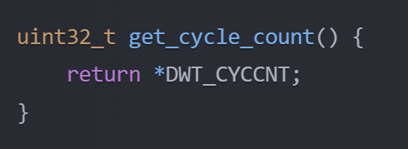
Tools: Performance counters
Most modern CPUs have built-in performance counters
Number of instructions
Number of cache misses/hits, branch prediction
Software interfaces possible:
ARM data watchdog and trace (DWT)
Directly read register
Hardware specific

Slide 23
Summary
Debugging : Correctness vs Profiling : Performance
Crucial for constrained and resource limited systems
Proper understanding of system and tools essential

Slide 24
Static Analysis

Slide 25
Static Analysis
Compile Time instead of Run Time
Compiler analyzes code “statically” - without running
Identify potential problems
Style errors or recommended practices

Slide 26
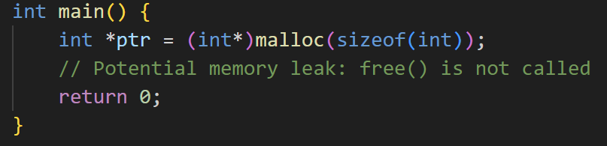
Example: memory bugs
C compiler can be very “forgiving”
Strict behaviour is better to catch problems early

Slide 27
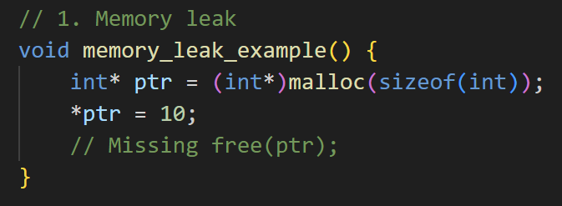
Types of issues

Slide 28
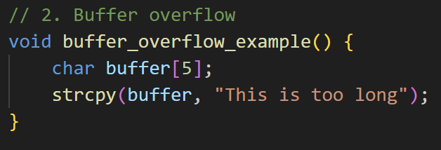
Types of issues

Slide 29
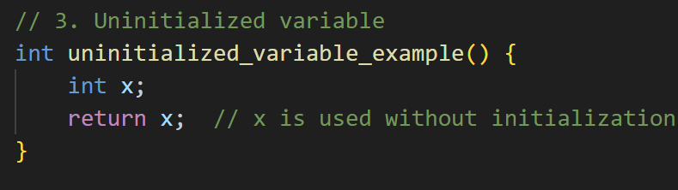
Types of issues

Slide 30
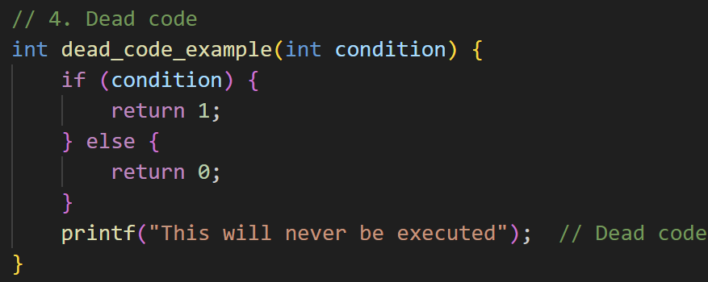
Types of issues

Slide 31
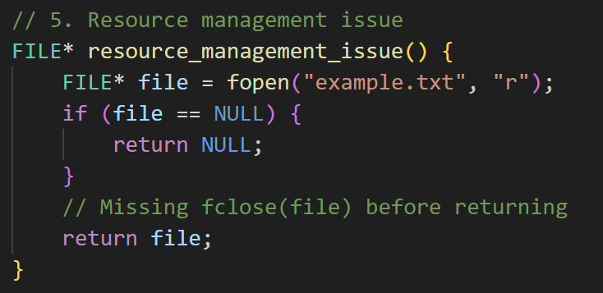
Types of issues

Slide 32
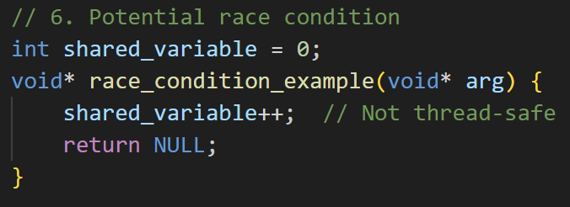
Types of issues

Slide 33
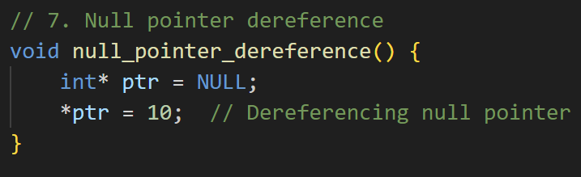
Types of issues

Slide 34
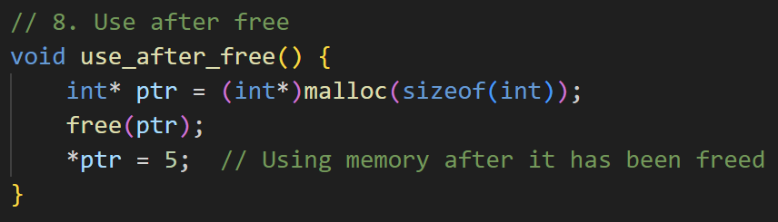
Types of issues

Slide 35
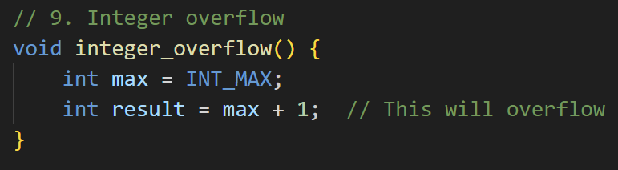
Types of issues

Slide 36
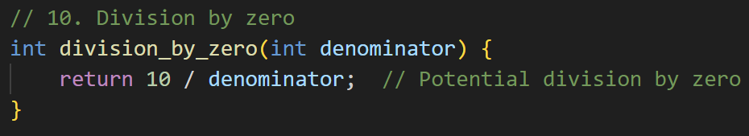
Types of issues

Slide 37
Code checkers
clang - compiler toolkit with support for static analysis
Most compilers will provide some useful information
cppcheck - open source
Coverity, PC-Lint etc:
Plenty of commercial tools
Many are platform specific
Compliance with specific coding standards

Slide 38
MISRA
Motor Industry Software Reliability Association
Guidelines aimed at C/C++ development
Widely applicable across many classes of embedded systems
MISRA C:2012, C++:2008 standards
Rules for software
Mandatory, Required, Advisory categories
Required can be violated if sufficiently documented and justified

Slide 39
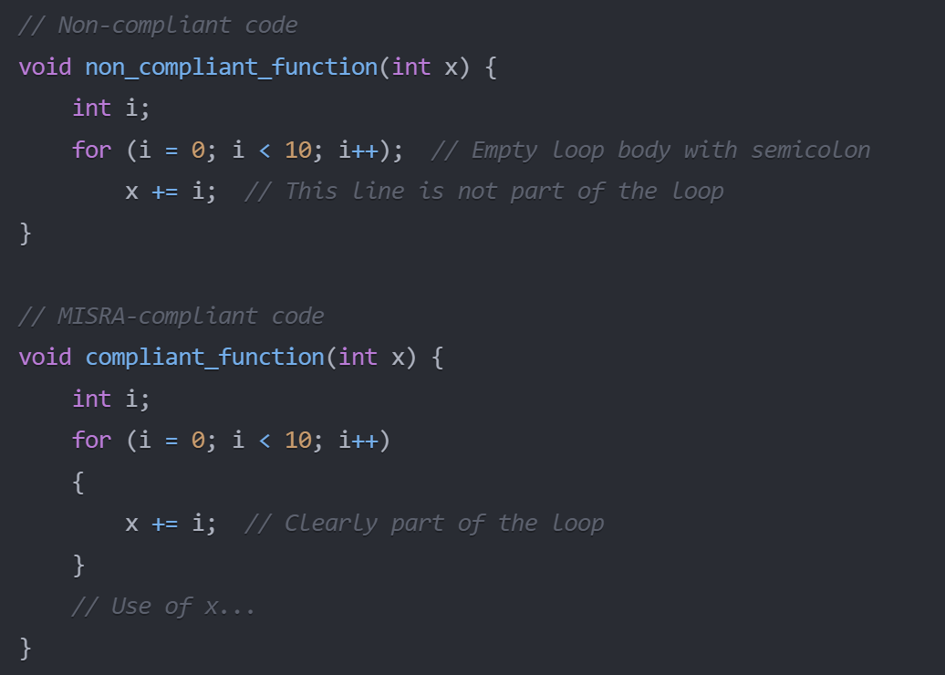

Slide 40
Summary
Static analysis: catch bugs early
Especially relevant for embedded systems
Resource constraints
Safety critical: standardized practices preferred
Predictability: eliminate some classes of undefined behaviour
Maintainability
Compliance - MISRA required in many contexts: aviation, motor etc.

Slide 41
Testing

Slide 42
Testing
Why should code be tested?
Basic functionality
Behaviour in corner cases: extreme environments, uncertain inputs
Guarantees of correctness?
How to test code?
What parts of this can be automated?

Slide 43
Unit Tests
Test each function as a separate unit
Ideally write tests before writing the function (test-driven development)
Tests for a function should never fail even after subsequent modifications
“Regression testing”
Ensure no “regressions” - no break in test after changes
Test suite:
large collection of small tests
should run fast - typically run several times over software lifecycle
automated - no manual intervention - report generated at end

Slide 44
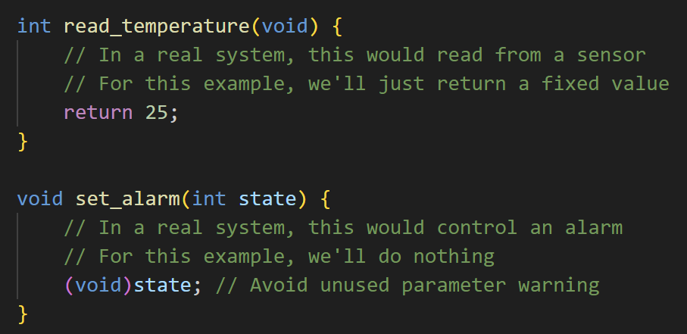
Example code to be tested

Slide 45
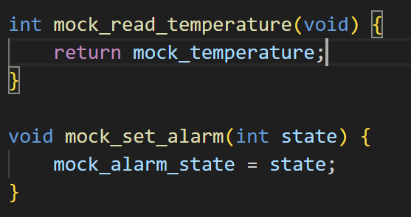
Mock functions

Slide 46
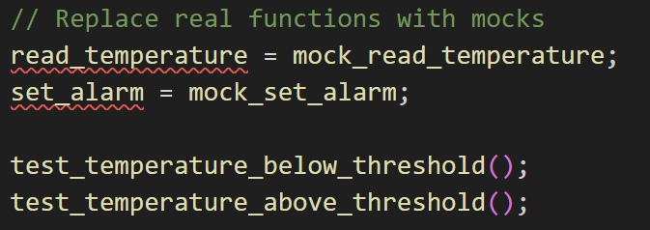
Function pointers and Function replacement

Slide 47
Unit Testing
Unit testing involves verifying that individual units of code, such as functions or modules, behave as expected when isolated from the rest of the system.
Example: Testing a function that checks an ADC (Analog-to-Digital Converter) output to ensure it returns the correct value for different input voltages. This is a unit test because it focuses on a single, self-contained function and doesn't depend on external hardware or other components.

Slide 48
Integration Testing
Integration testing involves verifying that multiple units of code work together correctly when combined in various ways.
Example: Testing a system that controls a DC motor using a PID (Proportional-Integral-Derivative) controller. This test would verify that the motor speed responds correctly to changes in input commands, and that the PID controller is functioning as expected.

Slide 49
System Testing
System testing involves verifying that the entire embedded system behaves as expected from an end-user perspective.
Example: Testing a system that controls a robotic arm using multiple sensors (e.g., encoders, accelerometers) and actuators (e.g., motors). This test would verify that the robot moves correctly in response to user input commands, and that all sensor readings are accurately used to control the movement of the arm.

Slide 50
Acceptance Testing
Acceptance testing involves verifying that the embedded system meets the requirements and expectations of stakeholders, including users or customers.
Example: Conducting a demo with potential customers to show how a robotic system for packaging goods can be integrated into their existing manufacturing process. This test would verify that the system is easy to use, reliable, and meets all relevant safety standards.

Slide 51
HIL Testing
Hardware-in-the-loop testing involves simulating real-world hardware scenarios in a controlled environment to test the interaction between the software system and external hardware components.
Example: Simulating a traffic light control system using real-world traffic patterns, including car movement, pedestrian activity, and weather conditions. This would allow for thorough testing of the system's response to different scenarios without risking actual safety or disrupting normal operations.
Particularly important for embedded systems!

Slide 52
Best Practices
General guidelines
Understand the system requirements - not just individual functions!
Isolate components - UNIT tests
Real world scenarios
Multiple test cases
System level tests
Automate!
Embedded Systems
Validation of sensor data
Safety critical tests
Power consumption

Slide 53
Best Practices
General guidelines
Understand the system requirements - not just individual functions!
Isolate components - UNIT tests
Real world scenarios
Multiple test cases
System level tests
Automate!
Embedded Systems
Validation of sensor data
Safety critical tests
Power consumption
KEEP IT SIMPLE

